Slide 1

Mule 4 PwC Json Logger
DRAFT
May 06, 2020
Confidential Information for the sole benefit of the recipient

Slide 2
Agenda
Overview
PwC json logger features
PwC json logger module
How to use it?
Encryption in logger
Payload decryption
Performance of PwC json logger v/s Mule OOB logger

Slide 3
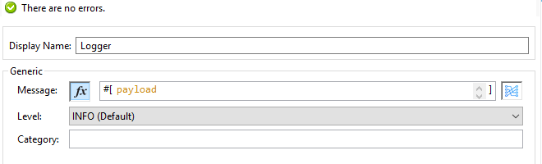
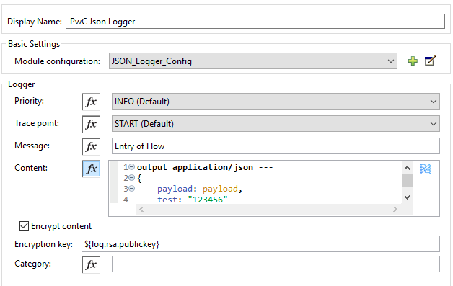
Overview
As a part of “software development life cycle” (SDLC) it is known that
an application may crash, a server may go down and an user may
realize that some invaluable data is missing without a clue
An efficient logging and monitoring infrastructure allows sysadmins,
support teams and application developers to be more prepared
to troubleshoot the aforementioned problems
Logging plays an important & inseparable part in
software development
The “out of the box” logger component offered by MuleSoft is
really easy to use but it hardly enforces any standards
and does not facilitate the creation of structured logs
With the help of “pwc json logger” we can standardize the
logging process across the business applications
Note: Json format is lightweight, flexible, efficient & human readable
Out of the box mule logger
PwC json logger

Slide 4
PwC Json Logger Features
Traceability:
CorrelationId (Correlate Request & Response with an unique Id):Json Logger by default generates & maintains unique correlation id in Log which helps to provide end-to-end visibility of data processing across three layer of APIs i.e. System/Process/Experience API layers
TracePoint: Trace Points aims to facilitate the standardization of certain “checkpoints” throughout the flow execution, which, in turn, enable more intelligent dashboards and reporting.
(1) START(Default) (2) BEFORE_API_OR_BACKEND (3) AFTER_API_OR_BACKEND (4) BEFORE_TRANSFORM (5) AFTER_TRANSFORM (6)END
Enforcement of meaningful message:Share meaningful non-sensitive functional messages such as “Request received to create new loan in core banking system”
Separate section for payload logging:Share raw request/response payload to troubleshoot
Location Information:Provide critical troubleshooting information such as the name of the flow, name file name, exact line number where the logger is located
Disabled fields:It will filter certain log information from not being printed in logs, example: “location information”

Slide 5
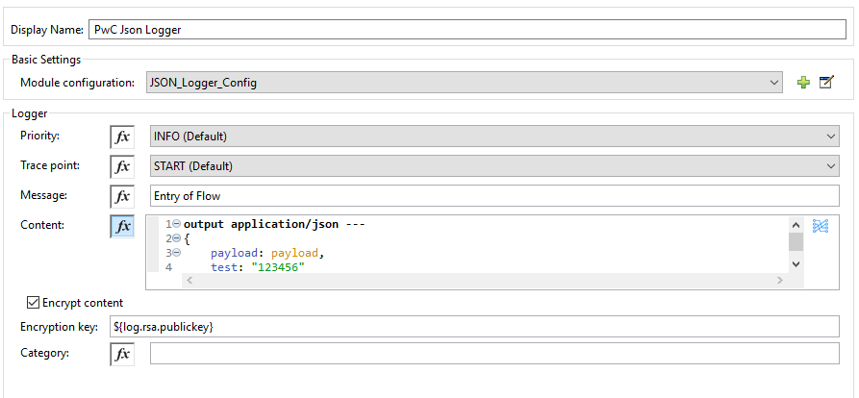

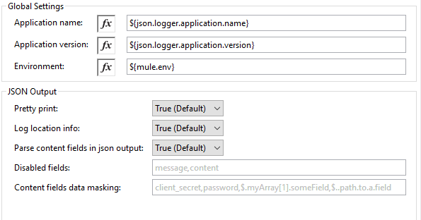
PwC Json Logger Module

Slide 6
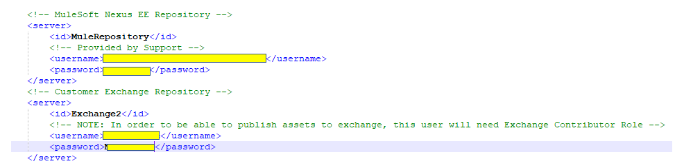
How to use Json Logger?
Developers need to go through the following steps to integrate “PwC json logger” mule component in their application: Step-1: Download “PwC json logger” component from “Anypoint Exchange” & install it in “Anypoint Studio” palette
[Note : This custom component will be available under “Customer Exchange” section in Anypoint Platform]
Step-2: Configure PwC json logger section to provide (1) Trace point (2) Message (3) Content etc
Step-3: Share the value against following properties as a part of properties file or runtime configuration section:
(1) mule.env (2) Json.logger.application.name (3) json.logger.application.version
Step-4: Configure settings.xml to share credentials of “MuleSoft Nexus EE Repository ”

Slide 7
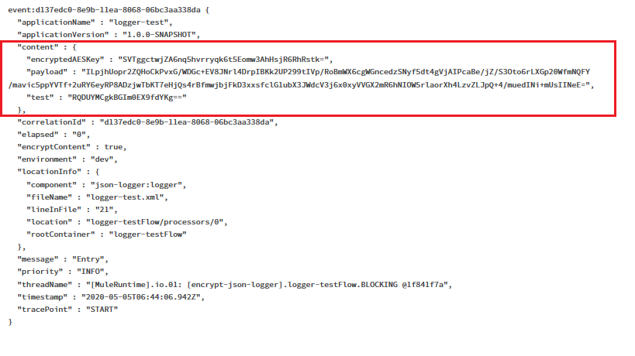
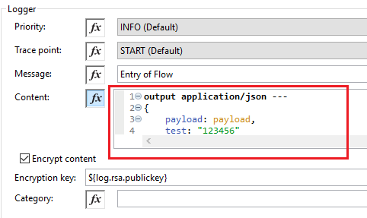
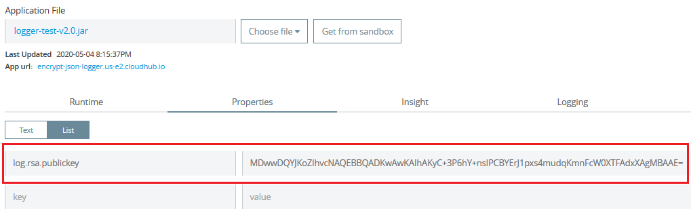
Encryption in Logger
Payload & other information provided inside the “Content” section will get encrypted with the “Encryption key” when “Encrypt content” box is checked
Cloudhub console output
PwC json logger configuration
Runtime manager settings

Slide 8
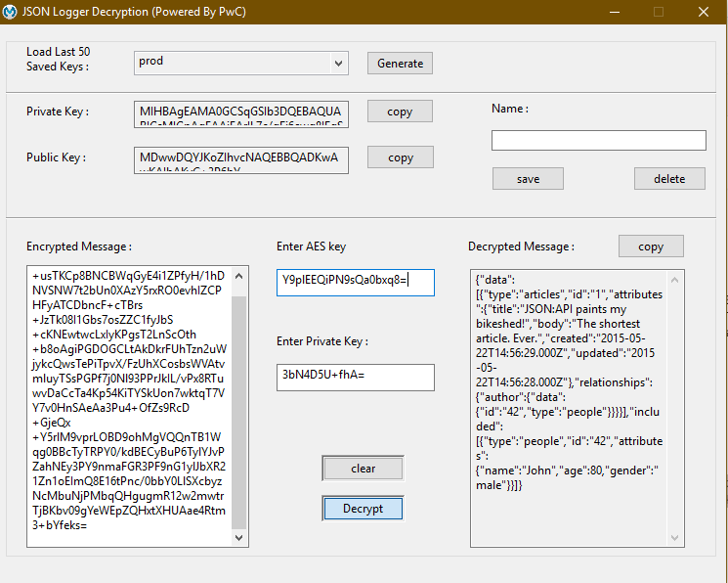
Payload Decryption
“pwc-jsonLoggerDecryption” desktop
application helps with following activities:
Generate RSA “public key”
& “private key”
Decipher encrypted payload using
“encrypted AES key” & “private key”
Save the keys for future reuse
Delete unused keys
Copy content by using “copy” button

Slide 9
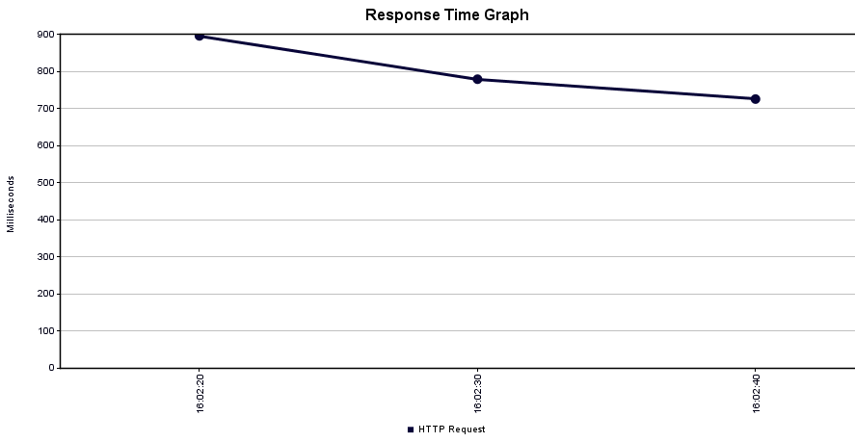
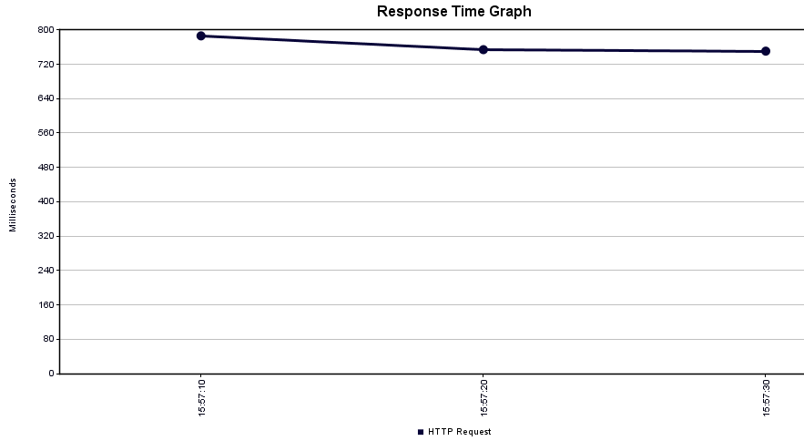
Performance of PwC Json Logger v/s Mule OOB logger
Tool used : Apache JMeter
Performance parameters : (1) Number of users : 1 (2) Ramp up period : 10 milliseconds (2) Loop count : 40
MuleSoft connector/component used : (1) HTTP listener (2) Logger (3) Dataweave Transformer
PwC json logger
Average response time : 752 milliseconds
Mule out the box logger
Average response time : 740 milliseconds

Slide 10
Q & A

